Slide 1
Solutions Overview
March 14, 2014

Slide 2
About RF Code
Wire-free Solutions for over 10 years
Based in Austin, Texas
RF Code’s solutions are comprised of hardware and software platforms that provide real time asset management and wire-free environmental monitoring

Slide 3
RF Code Solutions
Physical Asset Tracking Solutions
Wire-Free Monitoring Solutions
Fully automated “real-time location system”
Critical assets, locations & people
Environmental Monitoring
Power Monitoring

Slide 4
Product & Technology Introduction

Slide 5
RF Code Solution Components
Tags
Asset Tags
Sensor Tags
Readers
Wired
Middleware
Zone Manager
Applications
Asset Manager
Wi-Fi
RTLS Devices
Rooms
IT Racks
Proximity
Asset Manager Mobile

Slide 6
Solution Architecture
RF Code Solution Components
Open API Interfaces
Asset Manager Software
Open API
Full database
Local or remote
Tag to asset association
Customizable schema
Different user levels
Alerting engine
Web Based API
Data Output: XML, JSON, CSV
Zone Manager Software
Open API
Web Based API
Telnet Style API
Data Output: XML, JSON, CSV
Location engine (middleware)
Reader management
Configurable rules
Data Reduction
Change Value Reporting
Subscription Interface
Active RFID Readers
Open API
Highest density
Rules engine
Fixed, Mobile, Rack versions
POE option
Wireless option
Telnet Style API
Available via Network or Serial
Data Output: Text Based
Active RFID Tags
5 year life
Small size
Low Price
Multiple form factors
Asset Tracking Tags
Sensor Tags

Slide 7
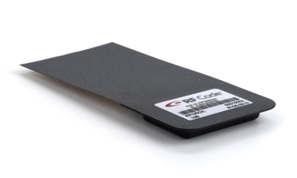
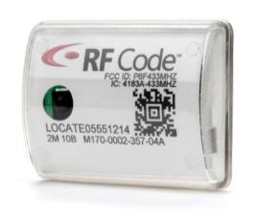
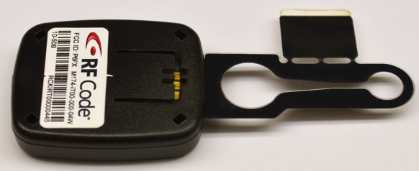
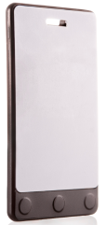
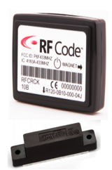
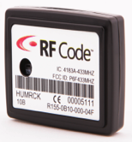
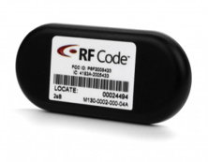
Asset & Sensor Tags – multiple tag types and enclosures
M170 Durable Tag
M174 IR IT Asset Tag
R100 Rack Asset Tag
R120 Rack
Door Tag
R155 Temperature
& Humidity Tag
M130 Asset Tag
R142 Badge Tag

Slide 8
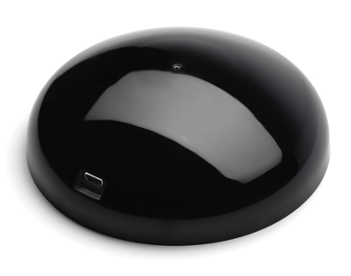
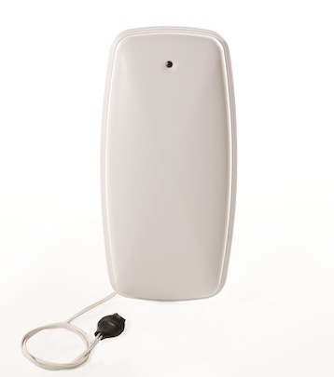
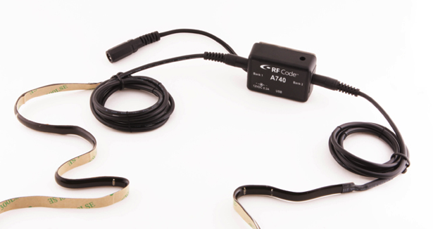
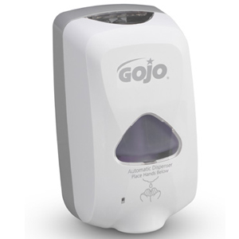
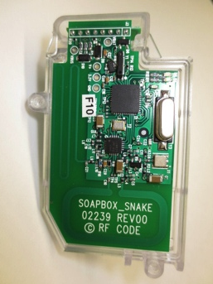
RTLS Devices
A750 Room Locator
(IR illuminator for rooms)
A760 Proximity Locator
(short range proximity detection)
A740 Rack Locator
(IR illuminator for IT racks)
A761 Proximity Locator for GoJo
(short range proximity detection)

Slide 9
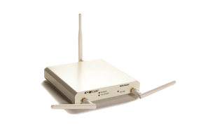


RF Code M250 Reader
M250 Fixed Reader:
Collects all tag radio frequency transmissions
Connects to IP network (wired or WiFi)
Integrated rules engine
Supports multiple simultaneous connections
Open APIs
Capacity & Coverage:
Single reader can receive signals from up to 1400 tags simultaneously
Support for Garmin GPS via USB
Typically covers:
75 feet LoS or 17,000 square feet in open space
25 feet LoS or 2,000 square feet in the data center

Slide 10
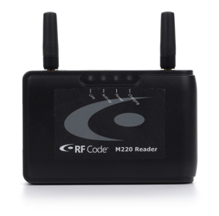

RF Code M220 Reader
M220 Mobile Reader:
Collects all tag radio frequency transmissions
Capacity & Coverage:
Single reader can receive signals from up to 1400 tags simultaneously
Typically covers:
25 feet LoS or 2,000 square feet in the data center
Mobile applications & scenarios
Integrated rules engine
Bluetooth connectivity to handheld
Battery powered (~ 8 hours run time)
Open API’s
75 feet LoS or 17,000 square feet in open space

Slide 11
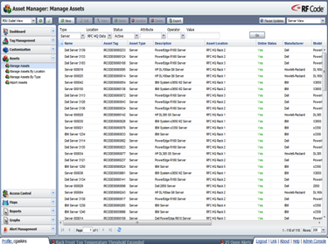
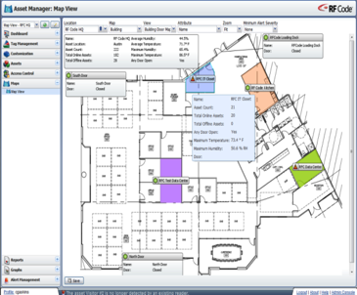
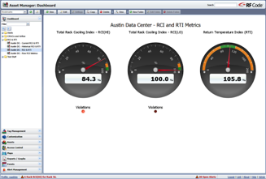
Asset Manager – Enterprise-class Asset & Sensor Management
Full Asset Life Cycle Management:
Tag to asset association
Quick access dashboard views
Asset searching, reporting, and graphing
Asset thresholding and alerting
Enterprise-class Monitoring:
Integration with all RF Code wire-free sensor tags
Ideal for both small and enterprise, multi-site applications
Fully support for RCI & RTI metrics
Integration modules available (IBM, Modbus, Bacnet, etc..)
Open API available for easy integration
Table Views, Map Views, Reporting & Graphing:
Flexible Dashboards
Live table views
Interactive map views
Scheduled & Interactive reporting & graphing
Easily export all data in multiple formats
Advanced Thresholds & Alerting:
Policy based thresholding & thresholding for time
Centrally configured thresholds simply administration
Five levels of alert severity
Alert actions include email, SNMP traps, HTTP post, etc..
Customizable asset database & schema

Slide 12
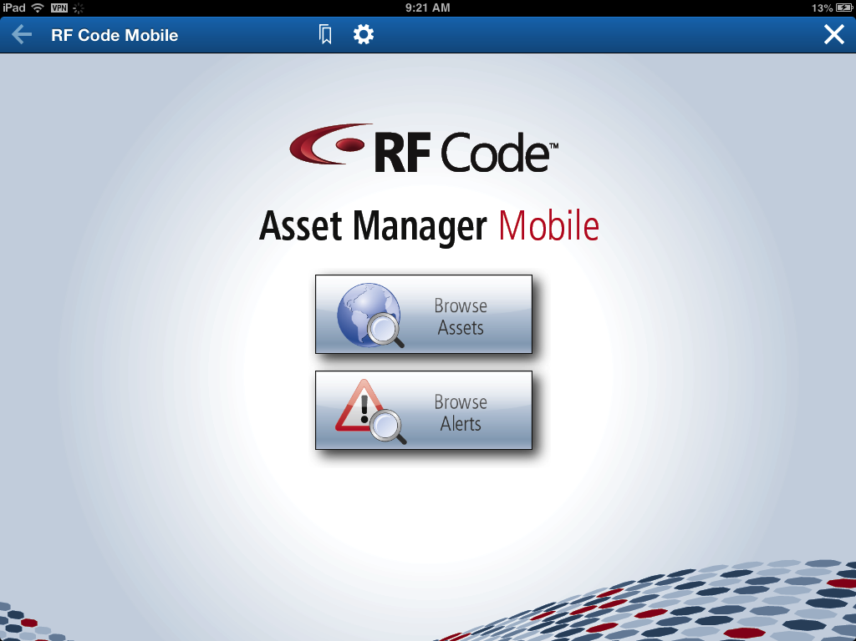
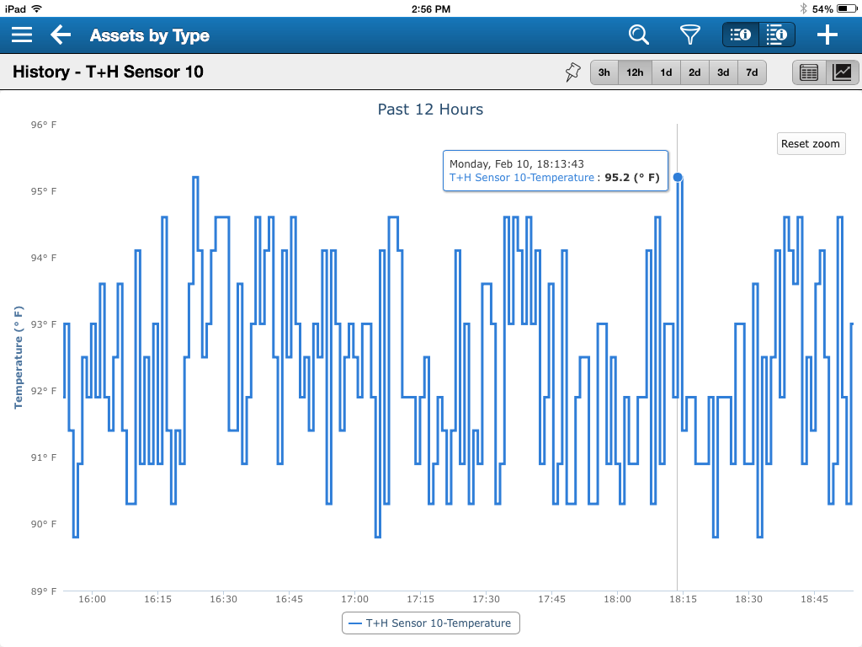
Asset Manager Mobile
Mobile Access Anywhere
Easily access Asset Manager from mobile devices
Alerts
Access Asset Manager alert details easily and quickly
Support for Apple iOS tablets and smartphones
Support for Android based tablets and smartphones
Search, Browse, Add, Edit, Delete
Quickly find assets and sensors global search, browse by type, and browse by location
Add, edit, and delete assets and sensors from any location
Browse alerts by type and date
Links from alerts to offending asset or sensor
View real-time and historical sensor data

Slide 13




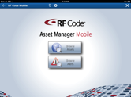


Asset Manager Software - Scalable Architecture
Asset Manager
(Web Console)
Headquarters Data Center
SQL Database
Server
Asset Manager
Mobile
Asset
Manager
Location A
Location B
Location C
Remote
Zone Manager
Remote
Zone Manager
Remote
Zone Manager
RF Code Fixed Readers
RF Code Fixed Readers
RF Code Fixed Readers

Slide 14
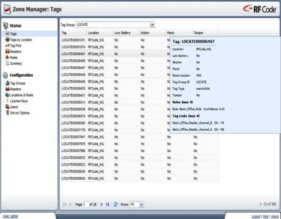
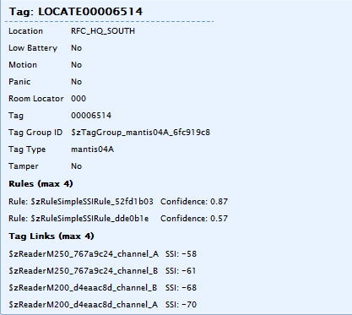
Zone Manager - Software
Middleware Location Engine:
Configurable location rules engine
Data Reduction Capabilities:
Reduces redundant data or unnecessary data flow
Subscription interface for attribute change notifications
Integrate with other Applications:
Open API (Telnet API & Web API)
Data available in multiple formats XML, JSON or CSV
Works with readers to determine precise location
Simple web based configuration
Highly scalable
Integration modules for IBM, Microsoft, & others

Slide 15





Available Add-on Software Add-on Modules
Advanced Reporting Module
Provides advanced reporting capabilities
Designed for Asset Manager
JMX & Tivoli Monitoring Module
Publishes data via the Java Management Extensions standard & via Tivoli Monitoring agent
Designed for Asset Manager
BACnet Integration Module
Publishes data via BACnet TCP/IP standard
Designed for Asset Manager
Modbus Integration Module
Publishes information to the Modbus IP standard
Designed for Asset Manager
OPC Server
Publishes information via the OPC standard
Designed for Zone Manager
Business Intelligence Reporting Tool

Slide 16
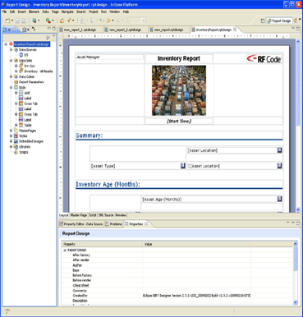
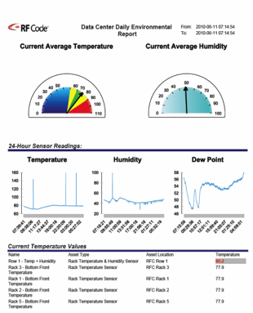
Advanced Reporting Module for Asset Manager
Graphical Report Designer
Customized Headers & Footers
Watermarking
Grids and Tables
Various Types of Charts and Graphs
Formatted Lists
Static Images
Data Transformations
Data from external data sources (other databases)
Compound Reports
Export in Multiple Formats

Slide 17


Common Solution Architectures
Stand-alone
Solution
IBM Maximo
DCIM Applications
Other
Integrated
Solution
Asset Manager
(Enterprise Console)
SQL Database
Server
Asset Manager
(Data Manager Component)
3rd Party Platforms
Using Open APIs
Asset Manager
(Zone Manager Component)
Zone Manager
RF Code
Standard Readers
RF Code
Standard Readers
RF Code
Standard Readers
RF Code
Standard Readers
Notes:
17

Slide 18
Enterprise Asset Tracking
Notes:
18

Slide 19
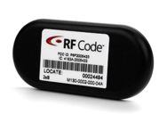
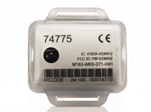
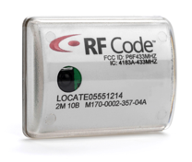
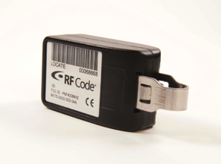
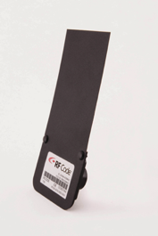
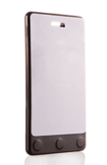
Asset Tag Overview
Small form factor
Long battery life (5 years)
Some Enclosures are Infrared Capable
Typically Transmits data every 10 seconds
Operates at 433Mhz radio frequency
Long range (optimal 300+ feet)
Low signal attenuation around metal
Simply to deploy
Various Enclosure Types for Multiple mounting options

Slide 20
Five Levels of Asset Visibility
Zonal for Distributed Assets
Critical or high dollar assets in a distributed environment such as a office, warehouse, healthcare, etc.
Provides general (zone level) asset location information as well as sensor monitoring
Most common and easy deployment
Notes:
20

Slide 21
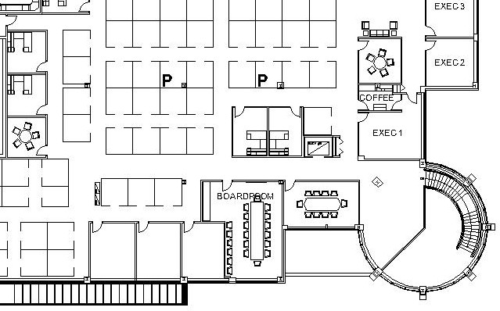

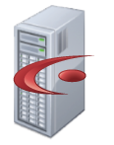
Zonal Distributed Asset Tracking – Example
Zone 1
Zone 2
Zone 3
Asset Manager
Software
Zone 4
Zone 5
Zone 6
Notes:
21

Slide 22
Five Levels of Asset Visibility
Zonal for Distributed Assets
Critical or high dollar assets in a distributed environment such as a office, warehouse, healthcare, etc.
Provides general (zone level) asset location information as well as sensor monitoring
Most common and easy deployment
Zonal for Data Center Assets
Inventory and tracking of assets in a data center with open racks
Provides general room level location information as well as sensor monitoring
Notes:
22

Slide 23
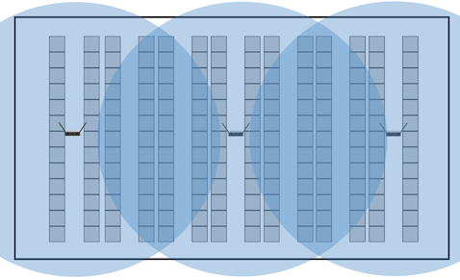
Zonal for Data Center - Example
Real time inventory
Greater than 95% accurate
Zone or area location tracking
Works with open & closed racks
Easy to deploy
Fast ROI
Asset Manager
or
Zone Manager
Data Center
Notes:
23

Slide 24
Five Levels of Asset Visibility
Zonal for Distributed Assets
Critical or high dollar assets in a distributed environment such as a office, warehouse, healthcare, etc.
Provides general (zone level) asset location information as well as sensor monitoring
Most common and easy deployment
Zonal for Data Center Assets
Inventory and tracking of assets in a data center with open racks
Provides general room level location information as well as sensor monitoring
Rack Level for Data Center Assets
Inventory and tracking of assets in data center racks
Provides rack level location as well as sensor monitoring
Notes:
24

Slide 25

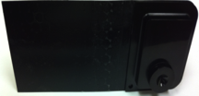
A740 - Rack Location Solution
Automated real time inventory
Rack level location precision
Greater than 95% rack location accuracy
Rack infrastructure (A740) does not consume a “U” space
Works with open & closed racks
Easy to deploy
Fast ROI
A740 Rack
Locator System
IR
Light Strip
R104 Asset Tag

Slide 26


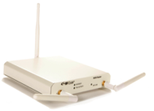
Infrared + RFID - Rack Location Solution
A740 IR system installed in each rack:
A740 control box (only requires power)
2 IR light strips
How it works:
Each A740 emits a unique ID via infrared
Each IR enabled asset tag in the rack receives the unique IR ID
When each IR enabled asset tag transmits its radio frequency beacon, it includes the IR ID that it is currently “seeing”
RF Code software (ZM/AM/SM) interprets the IR ID to determine the location of the asset tag
A740
Rack Locator
Unique
IR ID
IR Enabled
Asset Tag
M250
Reader

Slide 27

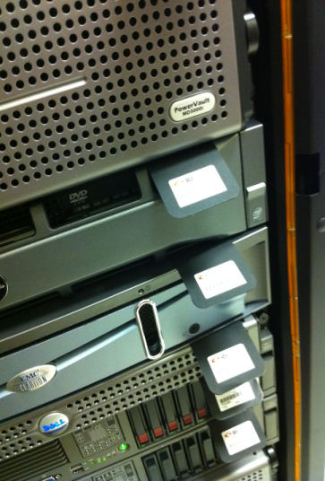
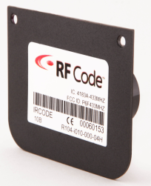
IR Rack Solution Photos
R104 IR Enabled Asset Tag
R114 IR Enabled Asset Tag

Slide 28
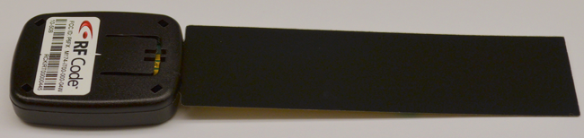
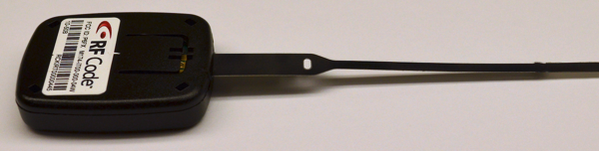

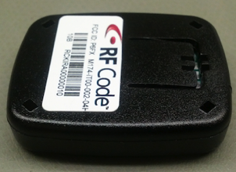
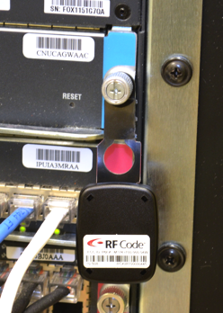
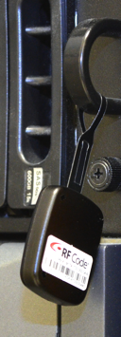
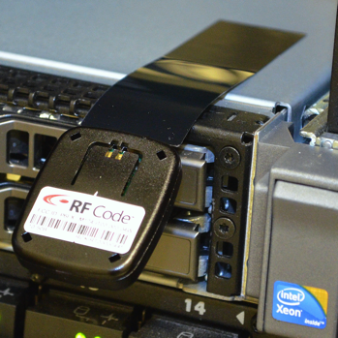
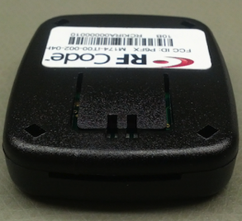
M174 – IR Enabled IT Asset Tag
Next Generation Design
Designed specifically for IT Asset Tracking in data centers
40% smaller than existing IT Asset Tracking tags
Reusable as assets phase out before tag life expires
5 year battery life
Enhanced IR Capability
Compatible with A750 Room Locators and A740 Rack Locators
Utilizes 4 IR receives enhancing ability to “see” IR location signals
Flexible Attachment Tabs
Disposable attachment tabs affix tag to asset
3 types of tabs enables maximum attachment flexibility

Slide 29

Data Center Asset Tracking Example
Staging Area
Racks # 1-8
Racks # 25-32
Racks # 41-48
Racks # 17-24
Racks # 9-16
Racks # 33-40
Example Output:
Server 150 is located in Staging Area, which is located in Building 1.
Example Output:
Server 150 is located in Rack 48, which is located in Building 1.
Example Output:
Server 150 is located in Loading Dock, which is located in Building 1.
Example Output:
Server 150 is located in Storage Area, which is located in Building 1.
Connected to each reader in each zone
Determines precise zone level location
Loading Dock
Storage Area
Asset Manager

Slide 30
Five Levels of Asset Visibility
Zonal for Distributed Assets
Critical or high dollar assets in a distributed environment such as a office, warehouse, healthcare, etc.
Provides general (zone level) asset location information as well as sensor monitoring
Most common and easy deployment
Zonal for Data Center Assets
Inventory and tracking of assets in a data center with open racks
Provides general room level location information as well as sensor monitoring
Rack Level for Data Center Assets
Inventory and tracking of assets in data center racks
Provides rack level location as well as sensor monitoring
Room Level for Distributed Assets
Critical or high dollar assets in a distributed environment such as a office, warehouse, healthcare, etc.
Provides Room Level asset location when using IR enabled tags and IR Room Locators
Easy to deploy
Notes:
30

Slide 31
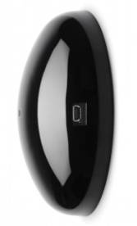

A750 - Room Location Solution
Works in concert with 433 MHz infrared-enabled tags
Provides specific room location information
Range is approximately 20 feet linear or 400 square feet room
Only requires power
Low cost and simple to deploy
IP Network
A750
Room Locator
Unique
IR ID
M250 Reader
IR Enabled Tags

Slide 32
Infrared + RFID - Room Location Solution
A750 IR system installed in each room:
A750 Room Locator (only requires power)
How it works:
Each A750 emits a unique ID via infrared
Each IR enabled asset tag in the room receives the unique IR ID
When each IR enabled asset tag transmits its radio frequency beacon, it includes the IR ID that it is currently “seeing”
RF Code software (ZM/AM/SM) interprets the IR ID to determine the location of the asset tag
Works in conjunction with IR enabled asset tags and M250 readers

Slide 33





A750 Product Overview - Deployment Example
Deploy one (or more) Room Locator per room
Each Room Locator emits an infrared signal with a unique ID.
Infrared enabled tags receive the infrared signal
Understand in real-time, which room an asset is currently located for quick access and inventory purposes
Hallway
Room 1
Room 2
Room 3
Room 4

Slide 34
Five Levels of Asset Visibility
Zonal for Distributed Assets
Critical or high dollar assets in a distributed environment such as a office, warehouse, healthcare, etc.
Provides general (zone level) asset location information as well as sensor monitoring
Most common and easy deployment
Zonal for Data Center Assets
Inventory and tracking of assets in a data center with open racks
Provides general room level location information as well as sensor monitoring
Rack Level for Data Center Assets
Inventory and tracking of assets in data center racks
Provides rack level location as well as sensor monitoring
Room Level for Distributed Assets
Critical or high dollar assets in a distributed environment such as a office, warehouse, healthcare, etc.
Provides Room Level asset location when using IR enabled tags and IR Room Locators
Easy to deploy
Proximity Detection
Short range RF proximity location
Understand who does what, where, and when
Notes:
34

Slide 35
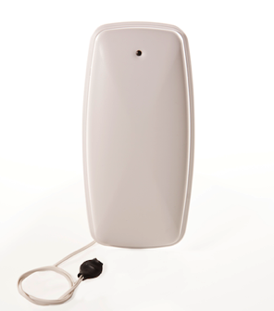
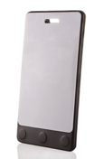
RF Code’s Proximity Detection System
RF Code’s proximity detection system is designed to work around “actions” that require human interaction.
The system is comprised of the A760 Proximity Locator (A760-0003) and the R142 IR & proximity enabled badge tag (R142-i3RF).
The A760 Proximity Locator is a battery-powered radio signaling device used in coordination with proximity-enabled personnel badges (R142) to answer “Who Did What, When & Where” questions:
Who pushed that button?
Who opened the freezer or refrigerator?
Who accessed the tool shed?
Who opened that door?
Who washed their hands?
A760
R14z2

Slide 36
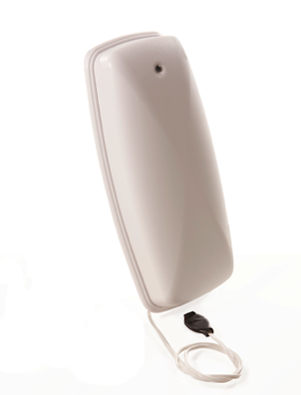
A760-003 Proximity Locator Specifications
Communications Capabilities:
Long range active RFID
Short range proximity detection
Dry contact input (open / close)
Long Range RFID Radio:
RFID Radio: 433MHz
RFID Radio Range: up to 300 feet
Short Range Proximity Radio:
Proximity Radio: 915MHz
Proximity Radio Range: 2 to 6 feet
Size:
Height: 1.25 inches
Width: 4.0 inches
Length: 8.0 inches
Weight: 11.2 oz.
Battery:
Type & Quantity: 3 AA
Life: 4 years at 100 events per day
Designed for indoor use

Slide 37
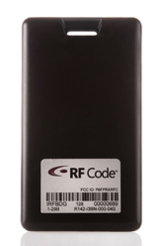
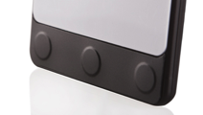

R142-i3RF Badge Specifications
Communications Capabilities:
Long range active RFID
Short range proximity detection
Infrared Receive / input
3 Button manual input
Long Range RFID Radio:
RFID Radio: 433MHz
RFID Radio Range: up to 300 feet
Short Range Proximity Radio:
Proximity Radio: 915MHz
Proximity Radio Range: 2 to 6 feet
Size:
Width: 2.232 inches
Depth: 3.949 inches
Height: 0.28 inches
Weight: 1.40 oz.
Construction:
Injection-molded polycarbonate enclosure
Durability:
Splash resistant
Battery:
Type & Quantity: 3 Lithium CR2032
Life: > 2 years (typical)

Slide 38

A760 Proximity System – How It Works
“Action” is initiated by a badged person.
A760 Wall Unit detects “action” event, transmits long range 433 MHz signal with unique ID & emits unique 915 MHz ID in short range field.
Badge receives 915 MHz transmission, decodes ID, and transmits an acknowledgement via 915 MHz.
Badge transmits via 433 MHz successful “transaction” including the ID of the Wall Unit.
Wall Unit transmits via 433 MHz a successful “transaction” completion.
A760 Proximity
Locator
433MHz Long Range
915MHz
Short Range
M250 Reader
433MHz Long Range
A750 Room Locator
Unique IR ID
R142 Badge Tag
Notes:
38

Slide 39


RF Code’s Proximity Detection System For GoJo TFX Dispenser
RF Code’s proximity detection technology is designed to work around “actions” that require human interaction such as opening a door, activating a switch, etc. and identifying who does what and when.
The A761 Proximity Locator is designed to work with the GoJo SmartLink enabled TFX Dispenser providing a fully integrated hand hygiene monitoring solution indicating who dispensed soap or hand sanitizer, at what time, and in what location.
The system is comprised of the A761 Proximity Locator installed in a GoJo TFX Dispenser, and the R142 IR & proximity enabled badge tag.
GoJo TFX
A761
R142

Slide 40
High Level Work Flow for Hand Hygiene
GoJo TFX Dispenser is activated by a badged person.
The SmartLink system activates the embedded A761indicating a dispense event. The A761 then transmits a unique 915 MHz ID in short range field.
Badge receives 915 MHz transmission, decodes ID, and transmits an acknowledgement via 915 MHz.
Badge transmits via 433 MHz successful “transaction” including the ID of the Wall Unit.
A761 transmits via 433 MHz a successful “transaction” completion indicator and the ID of the badge.
GoJo TFX Dispenser with RF Code A761
Wall
R142 Badge Tag
Notes:
40

Slide 41
Wire-Free Environmental & Power Monitoring

Slide 42
Data Center Monitoring Challenges
The high cost of wire
Expensive sensors and appliances
Time consuming and difficult to deploy / redeploy
Expensive to deploy
Inflexible
Mounting issues & awkward for use in front of racks
The high cost of power
Power and cooling costs exceed capital asset costs
Inability to optimize data center for energy efficiency, asset use
For every 1° F that air temperatures are reduced results a 2% power cost savings results

Slide 43





Solution Architecture
Asset Manager
(Enterprise Console)
SQL Database
Server
Asset Manager
RF Code Reader
RF Code Reader
RF Code Reader
RF Transmission
RF Transmission
RF Transmission
RF Code Sensor Tags
RF Code Sensor Tags
RF Code Sensor Tags
Notes:
43

Slide 44



Sensor Tag Overview
Small form factor
Long battery life (5 years)
Replaceable batteries
Transmits data every 10 seconds
Operates at 433Mhz radio frequency
Long range (optimal 300+ feet)
Low signal attenuation around metal
Simply to deploy
Multiple mounting options

Slide 45
RF Code M250 Reader
M250 Fixed Reader:
Collects all tag radio frequency transmissions
Connects to IP network (wired or WiFi)
Integrated rules engine
Supports multiple simultaneous connections
Open APIs
Capacity & Coverage:
Single reader can receive signals from up to 1400 tags simultaneously
Support for Garmin GPS via USB
Typically covers:
25 feet LoS or 2,000 square feet in the data center
75 feet LoS or 17,000 square feet in open space

Slide 46
Typical Reader Deployment for Data Center Sensor Solution
One reader per rack aisle
Mount reader above racks on ceiling
Install sensor tags in racks & around data center
Asset Manager
Data Center
Notes:
46

Slide 47


R150 - Temperature Sensor Tag
Sensor Type
Delivers ambient temperature wirelessly
Universal Mounting
Easy installation in any rack or room
Adhesive mounting
Screw mounting
Zip tie mounting
Sensor Specifications
-4° F to +158° F operating range
+ or – 1.5° F accuracy over -4° to 158° F
Tag Specifications
10 second beacon rate (standard)
5 year battery life
Replaceable battery
Low battery indicator
+ or – 1° F accuracy over 40° to 140° F
+ or – 0.47° F accuracy over 50° to 140° F

Slide 48

R150 Temperature Tag Deployment Options
Single or Multiple Sensors per Rack
Single tag per rack for minimal coverage
Three tags per rack (top, middle, bottom) for maximum coverage
Easy mounting on room walls:
Adhesive backing allows tag to “stick” to almost any surface
Flexible deployment and re-deployment approach
No wires needed – just move the tags
Bezels provide additional mounting options
Easily add more sensors as needed
R150 Temperature
Tag

Slide 49


R151 – Tethered Temperature Sensor Tag
Sensor Type
Delivers ambient temperature wirelessly
Universal Mounting
Easy installation in any rack or room
Adhesive mounting
Screw mounting
Zip tie mounting
Sensor Specifications
Tag Specifications
10 second beacon rate (standard)
5 year battery life
Replaceable batteries (3)
Low battery indicator
-67° F to 212° F operating range (probe)
+ or – 4° F accuracy over -67° to 212° F
+ or – 2° F accuracy over 14° to 185° F
+ or – 1.08° F accuracy over 50° to 140° F

Slide 50


R155 - Temperature + Humidity Sensor Tag
Sensor Type
Delivers ambient temperature & humidity wirelessly
Universal Mounting
Easy installation in any rack or room
Adhesive mounting
Screw mounting
Zip tie mounting
Sensor Specifications
-4° F to +158° F operating range
0% to 95% humidity range (+ or – 2%)
Tag specifications
10 second beacon rate (standard)
5 year battery life
Replaceable battery
Low battery indicator
+ or – 2° F accuracy over -4° to 158° F
+ or – 0.41° F accuracy over 50° to 140° F

Slide 51

R120 – Door Switch Sensor Tag
Sensor Type
Delivers door position wirelessly
Universal Mounting
Easy installation in any rack or room
Attach the R120 tag to the door frame
Attach the magnet to the door
Tag Specifications
10 second beacon rate (standard)
Immediate beacon when door opens
5+ years battery life
Replaceable battery
Low battery indicator

Slide 52

R130- Dry Contact Sensor Tag
Sensor Type
Delivers dry contact device state change wirelessly
Universal Mounting
Adhesive mounting
Screw mounting
Zip tie mounting
Tag Specifications
10 second beacon rate (standard)
Immediate beacon upon dry contact state change
5+ years battery life
Replaceable battery
Low battery indicator
Example dry contact output devices:
Motion sensors
Smoke sensors
UPS

Slide 53


R135 – Fluid Sensor Tag
Sensor Type
Delivers instant fluid detection wirelessly
Ideal Locations
Beneath raised floors in IT data centers
Wrapped around pipes in critical spaces
Floors of wiring and IT closets
Drip and condensation pans
Lab or manufacturing environments
Tag Specifications
10 second beacon rate (standard)
Immediate beacon when fluid is detected
5+ years battery life
Replaceable battery
Low battery indicator

Slide 54


R160 - Air Pressure Sensor Tag
Sensor Type
Delivers differential air pressure wirelessly
Ideal Locations
Above and below raised floors
Containment aisles
Sensor Specifications
Range: 0 to 0.5" H2O or 0 to 125 Pa
Resolution: ±0.001"H2O or ±0.25 Pa
Zero Point Accuracy: 0.002" H2O or 0.5Pa
Tag Specifications
10 second beacon rate (standard)
5+ years battery life
Replaceable batteries
Low battery indicator

Slide 55


R180 – 4-20mA Sensor Tag
Sensor Type
Interfaces with industry standard 4-20mA Sensors
Ideal Locations
Any location that requires specialized or industrial type sensors
Sensor Specifications
1.25uA resolution
Tag Specifications
10 second beacon rate (standard)
5+ years battery life
Replaceable batteries
Low battery indicator
Examples: Flow rates, vibration, fuel levels, etc.
±0.5% accuracy
100 ohm resistance
Loop supply not included

Slide 56






R180 4-20mA Sensor Tag
Supports industry standard 4-20mA sensors for specialty or industry specific applications
Enables wireless transmissions of 4-20mA sensors
Fully integrates with RF Code Zone Manager and RF Code Asset Manager
4-20mA Sensor
M250 Reader
Software
R180 4-20mA Sensor Tag

Slide 57


R170 - PDU Sensor Tag
Sensor Type
Provides power data from PDUs wirelessly
Eliminates wired connections to each PDUs
Eliminates IP address overhead for each PDU
Available Power Information
PDU data
Phase & feed line data
Outlet data
Breaker data
Tag Specifications
10 second beacon rate (standard)
5+ years battery life
Replaceable battery
Compatible with PDUs from
Raritan
Server Technology, Inc.
Geist Manufacturing
Low battery indicator
Emerson Network Power
APC PDU by Schneider Electric

Slide 58




M240 & Monitoring Bundle for Network & Telecom Closets
M240 Fixed Reader:
Collects all tag radio frequency transmissions for up to 20 sensor or asset tags
Connects to IP network (wired)
Integrated rules engine
Supports multiple simultaneous connections
Open APIs
Capacity & Coverage:
Single reader can receive signals from up to 20 tags simultaneously
Typically covers:
75 feet LoS or 17,000 square feet in open space
EM Bundle List Price = US $849.00
Contents:
1 M240 Reader
2 R155 Temperature & Humidity Sensor Tags
1 R150 Temperature Sensor Tag
1 R120 Door Position Sensor Tag

Slide 59
The Energy and Cooling Dilemma
A complex challenge of “Energy Usage vs. IT Reliability”
Too hot and equipment reliability suffers
Too cool and energy bills skyrocket
For every 1 degree F that rack air intake temperature is raised, 2% of the annual power costs can be saved
This complex challenge is an optimization problem
How to sustain optimal IT equipment reliability and not over cool the data center therefore wasting energy and money?
In order to optimize data center cooling, we must measure cooling at the rack level per the ASHRAE 2004 or 2008 or NEBS guidelines.

Slide 60
Recommended & Allowable Temperature Ranges
Recommended Range (statement of reliability):
Preferred facility operation; most values should be within this range.
Allowable Range (statement of functionality):
Robustness of equipment; no values should be outside this range.
Rack Intake
Temperature
Max Allowable
32°C
Over-Temp
Max Recommended
27°C
Recommended
Range
Allowable
Range
Min Recommended
18°C
Under-Temp
Min Allowable
15°C

Slide 61
3 Metrics for Data Center Cooling Optimization
Dr. Magnus Herrlin at ANCIS, Inc. has developed three key metrics:
Rack Cooling Index High (RCI_{HI})®
Rack Cooling Index Low (RCI_{LO})®
Return Temperature Index (RTI)TM
RCI is a best practice performance metric for quantifying the conformance with thermal data center guidelines and standards such as ASHRAE and NEBS.
RTI quantifies the energy performance of the air-management system. It is a measure of net by-pass air or net recirculation air in the equipment room.
Rack Cooling Index (RCI) is a Registered Trademark and Return Temperature Index (RTI) is a Trademark of ANCIS Incorporated
(www.ancis.us). All rights reserved. Used under authorization.

Slide 62
Rack Cooling Index (RCI)
RCI is a measure of compliance with ASHRAE or NEBS intake temperature guidelines and is expressed as a percentage (max = 100%)
RCI_{HI} is a measure of the absence of over-temperatures
100% means that no temperature is above the maximum recommended
Less than 100% means the greater the probability (risk) that equipment experiences temperatures above the maximum allowable (hotspots)
RCI_{LO} is measure of the absence of under-temperatures
100% means that no temperature is below minimum recommended
Less than 100% means the greater the probability (risk) that equipment experiences temperatures below the minimum allowable (over-cooling)
Poor | Acceptable | Good | Ideal
≤90% | 91% - 95% | ≥96% | 100%

Slide 63
Return Temperature Index (RTI)
RTI is a measure of net by-pass or net recirculation air. It is the ratio of total equipment airflow to total air-handler airflow expressed as a percentage.
100% means balanced airflow
<100% indicates net airflow by-pass
Cold supply air returns directly to CRACs without cooling the IT equipment: Elevated fan power, reduced chiller efficiency
>100% indicates net airflow re-circulation
Hot IT equipment exhaust is drawn back into intakes: Hotspots and reliability concerns.
Often results in low RCI_{HI}
Poor Airflow Net By-Pass | Target Airflow | Poor Airflow Net Re-circulation
<80% | 80% to 120% | >120%

Slide 64


Map View with RCI(HI) Overlay

Slide 65

Data Center Current RCI & RTI Dashboard

Slide 66
RF Code’s Implementation of RCI & RTI
RF Code’s Asset Manager software computes the following RCI & RTI Metrics:
RCI_{HI} & RCI_{LO} for each individual rack
RCI_{HI} & RCI_{LO} for each row
RCI_{HI} & RCI_{LO} for the entire data center
RTI for the entire data center
The data from these computed metrics can be utilized in multiple ways:
Real-time views (tables & dashboards)
Trending & reporting
Thresholding & alerting
Publish to BMS systems via OPC, Modbus/IP, & Bacnet/IP
Available via open API to 3rd party software

Slide 67
3 Levels of Data Center Thermal Monitoring
Basic:
Proactive thermal thermal monitoring at row or rack level
Alerting, reporting, graphing and dashboards via Asset Manager
Advanced:
Comply with ASHRAE thermal guidelines to reduce data center cooling expense and heat related equipment failure risk
Leverage RCI (Rack Cooling Index) metrics to optimize data center cooling
Optimal:
All of the “Advanced” items above
Desire for more operational efficiencies and fine grained monitoring to further reduce data center cooling expense (intake and exhaust)
Leverage RTI (Return Temperature Index) metric for more data center optimization

Slide 68
Rack Thermal Monitoring – Sensor Placement Best Practices
Minimal Rack Thermal Monitoring Best Practice
Supports Basic Thermal Monitoring, Row Level RCI & Data Center Level RCI
T
T
T
T
Intake
T+H
T+H
T+H
T+H
T
T
T
T
Optional sensors on rack exhaust
Exhaust
T+H
T+H
T+H
T+H

Slide 69
Rack Thermal Monitoring – Sensor Placement Best Practices
Optimal Rack Thermal Monitoring Best Practice
Supports Basic Monitoring, Rack RCI, Row RCI, Data Center RCI, & Data Center RTI
T
T
T
T
T
T
T
T
T
T
Intake
T+H
T+H
T+H
T+H
T+H
T+H
T+H
T+H
T+H
T+H
T
T
T
T
T
T
T
T
T
T
Required sensors on rack exhaust
T
T
T
T
T
T
T
T
T
T
Exhaust
T+H
T+H
T+H
T+H
T+H
T+H
T+H
T+H
T+H
T+H
T
T
T
T
T
T
T
T
T
T

Slide 70

RF Code Partner Integrations

Slide 71
RF Code Solution Advantages
Fully Automated, Wire-Free Solution:
Highly accurate inventory
Location information
Asset status
Asset movement
Tag tamper detection
Environmental & Power Monitoring:
Temperature
Humidity
Door Position
Dry Contact
Eliminates manual labor
Fluid Detection
PDU Power
Simple to deploy
Fast ROI
Multiple Use Infrastructure:
Asset tracking
Environment monitoring
Multiple applications
Multiple organizations
Real-time Asset Tracking:
Integration modules
Customizable software
Intelligent readers
Smart sensor tags
Small asset tracking tags
Leverages Intelligent Components:
Air Pressure

Slide 72

Visit www.rfcode.com
Email: sales@rfcode.com
Phone: 512.439.2200 main
Phone: 877.463.0756 sales (toll free)

