Slide 1




Motion CL920 Tablet PC
Product Overview

Slide 2
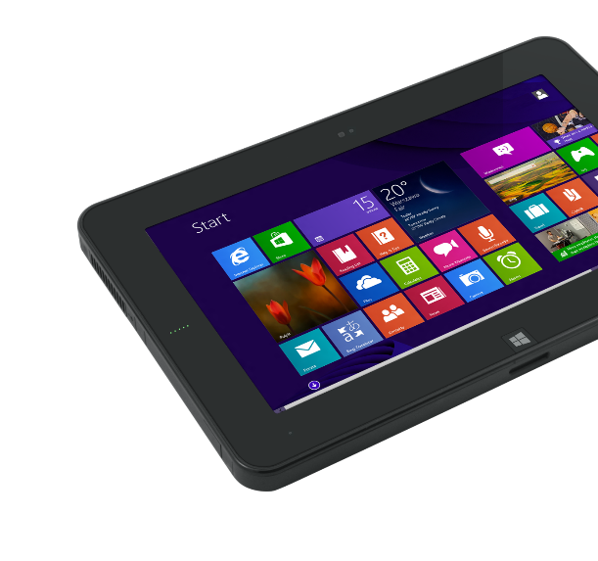
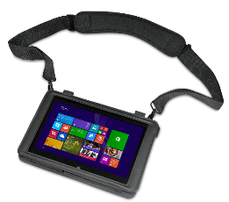
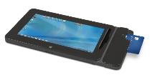
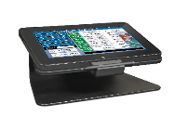
Introducing the new Motion® CL920
The Motion CL920 is an ultra-mobile tablet PC that balances performance, weight, durability, battery life and cost.
Ideal for running focused business applications, the CL920 offers business integration, mobility and documentation capabilities for improved data acquisition and transaction processing.

Slide 3
Motion CL920: What’s New?
We’ve improved the performance, connectivity and durability of the CL920
Feature | Current CL910 | New CL920 | Benefit
Processor / RAM | 1.6 GHz / 2 GB RAM | 2.7 GHz / 4 GB RAM | 69% faster processing
Wi-Fi / WWAN | abgn / 3G | ac / 4G LTE | More bandwidth, greater reliability
Cameras | 1.3 MP front / 3 MP back | 2 MP front / 5 MP back | High Resolution documentation capability
Durability | Aluminum frame / Gorilla Glass 2 | Magnesium frame / Gorilla Glass 3 | Greater survivability
USB | 2.0 | 3.0 Super Speed | 10x faster, bi-directional data transfer capability
Non-slip grip pattern | n/a | Motion Signature Grip Pattern | Extra grip-ability to prevent drops
Discrete GPS | GPS via WWAN | Ublox 7 (optional) | Dedicated GPS card provides location data when WWAN not included
Operating System | Windows 7 Pro | Windows 7 Pro or Windows 8.1 Pro | OS flexibility for your workflow
Battery life | ~7 hours | >8 hours | Full workday of battery life

Slide 4
Motion CL920: What’s the same?
We’ve maintained our commitment to platform stability with the CL920
Feature | New CL920 | Benefit
Docking Connection | Low-Profile durable connector | Backward compatible with CL-Series docks
Drop rating | Mil-Std-810G 4 feet | Durability for demanding environments
Ingress Protection | IP52 protected from dust and water | Sealed design makes cleaning and disinfecting easy
Expansion Module | SlateMate™ with Barcode Scanner and MagStripe Reader | Perfect for line-busting and inventory management
Display | 10.1” HD 1366 x 768 Dual bonded Display | Outdoor viewable 10-point touch and pen input supports modern interface and legacy applications
Electro-Mechanical Design | Same Architectural structure as CL900 and CL910 | Backward compatible within OEM solutions
Security | Trusted Platform Module, Computrace, WinMagic SecureDoc | Extra data and device protection with enterprise level manageability

Slide 5

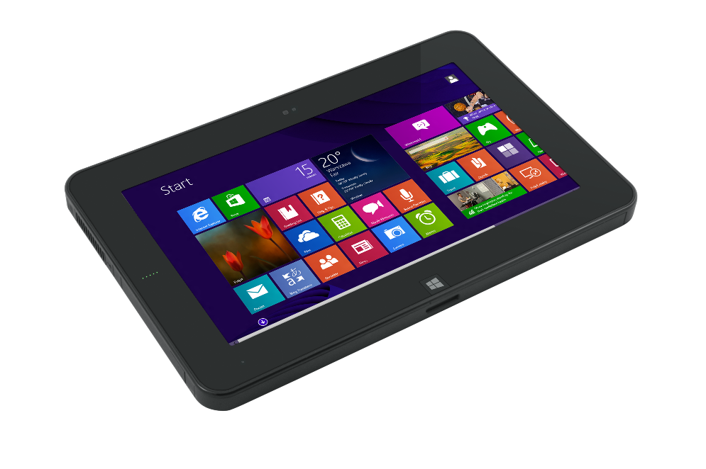
CL920 Key Features
Lightweight and durable for mobile environments
Outdoor viewable high definition display with 10-point touch and pen input
Pen storage barn with tether attach point
Integrated cameras for documentation and collaboration
SlateMate™ peripheral module for expandability
Grip pattern for extra slip resistance
Motion® CL920

Slide 6
Workflow Enhancing Peripherals
 | Retail Dock | Mobile Dock w/ Key Lock | SlateMate™ w/ BCS & MSR | Carry Sleeve | X-Strap
Inspect/Maintain/Repair
Line-Busting
Direct Store Delivery
Distribution
Inventory Management
Trade Contractors (HVAC, Electrical, etc.)
Home Healthcare
Construction punch-list generation
* Not all accessories shown

Slide 7

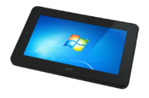
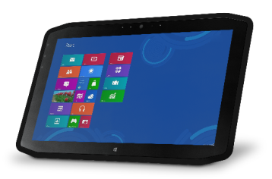
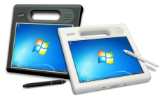
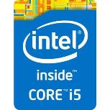

The Motion Platform Family: Where CL920 fits
Feature | Motion CL920 | Motion R12 | Motion C5te/F5te
Durable | MIL--STD-810G | MIL--STD-810G | MIL--STD-810G
Sealed | IP52-rated | IP54-rated | IP54-rated
CPU | Intel® Pentium™ N3540 | Intel® Core™ i5 or i7 vPro™ | Intel® Core™ i3; i5 or i7 vPro™
Integrated Components | Web camera, Documentation camera, Barcode scanner, MSR/Debit card reader | Web camera, Documentation camera, Barcode scanner, RFID reader, Serial Port | Web camera, Documentation camera, Barcode scanner, RFID reader, Smartcard reader
Advanced Communications | 802.11 ac wireless 4G LTE Gobi™ Connectivity GPS capabilities Bluetooth® 4.0 Module | 802.11 ac wireless 4G LTE Gobi™ Connectivity GPS capabilities Bluetooth® 4.0 | 802.11 a/b/g/n wireless Gobi™ Connectivity GPS capabilities Bluetooth® 4.0
Displays | 10.1” High Definition (1366 x 768) View Anywhere® display with Corning® Gorilla® Glass | 12.5” Full High Definition (1920 x 1080) View Anywhere® with Corning® Gorilla® Glass | 10.4” (1024 x 768) View Anywhere® with Corning® Gorilla® Glass
Battery Life | >8 hours | >10 hours (hot swappable) | > 6.5 hours (hot-swap)
Weight * Some features optional | ~1.97 lbs. | 2.9 lbs. | 3.3 lbs.

Slide 8
Motion Portfolio Target Workflow Comparison
F5 Workflow
Characteristics
Mission critical workflows, demanding high performance in the field
Demanding or hazardous environments
Spend most time on a work-site and/or in vehicle
Public Safety – Police, Fire, Ambulatory Services
Utilities – Line Workers
Manufacturing
Oil and Gas
Mining
Construction - Contractors
Military
R12 Workflow
Characteristics
Users split time between office and rugged field environments
Often in supervisory roles
Frequently moving between LOB apps and office productivity apps
Need large screen for content consumption & manipulation
Public Safety – Police/Fire
Construction – AEC, Site Supervisors
Insurance – Claims Agents
Utilities – Supervisors, Field Engineers
Health Care - Physicians
CL920 Workflow
Characteristics
Highly mobile with requirement for a lightweight & durable device
Task-oriented workflows, requiring sufficient processing power to run LOB specific apps or web-based apps
Mobile rugged projects under budget constraints
OEMs – Long life cycle solution
Retail – Mobile POS, line busting, specialty retail shops
Healthcare – Home Health, & Hospice service
Direct Store Delivery
Construction – Trade contractors, Inspectors
TYPICAL INDUSTRIES

Slide 9
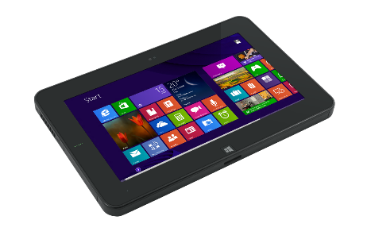

Summary
Easy to Integrate. Easy to Support. Easy to Deploy.
Designed for seamless integration; offering security, manageability and performance to support critical applications
Flexible for mobile work environments with a durable, bright display and peripherals to support “anywhere” computing
The light weight and mobility of a small form-factor device with the durability needed for demanding mobile workflows
Features SlateMate™ for flexible integration of documentation tools
Motion® CL920

Slide 10

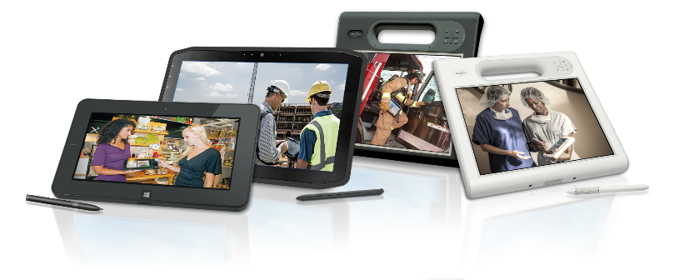

Slide 11
Additional Information

Slide 12

M
CL920 Specifications
Display | 10.1” Wide Display – (1366x768) with Gorilla Glass
CPU | Intel Pentium N3540 Dual Core (up to 2.66 GHz)
RAM | 4GB DDR3
HDD | 64GB , 128GB SSD options
Input | 10 Point-Touch and Digital Stylus
Webcam | 2 MP
Documentation Camera | 5 MP
OS | Windows® 7 Pro or Windows® 8.1 Pro
Graphics | Intel HD Graphics controller
Other I/O | USB 3.0, Combo Audio In/Out, Power, Docking Connector
Weight | 1.9 lbs. (.89 kg)
Wireless | Wireless 802.11 ac Wi-Fi 4G LTE Multi-Carrier Mobile Broadband
Bluetooth | 4.0 Module
Battery | Over 8 hours battery life*
Security software | Optional Computrace® theft protection
Warranty | 1-Year standard, Multi-Year Options
Media Card | Full-Size SD card
Audio | High Definition Audio Controller
Video | Micro-HDMI, Type D
Dimensions | ~.61 inches (15.5mm)
Durability | MIL-STD-810G spec IP52 rated
*Based on MobileMark 2007

Slide 13
Motion Portfolio Comparison
 | F5te/C5te | R12 | CL920
Rugged Factors
Outdoor Viewability
Integrated Features
Expandability
Serviceability
Communication*
Security
Weight
Price
Peripheral Ecosystem
Poor
Good
Best
* New F5/C5 will have equivalent communication capability.

Slide 14
Motion® CL920 Feature Overview

Slide 15
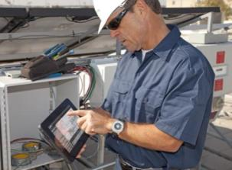
Built for Mobile Business
Enterprise-Ready Mobile Devices
Support Windows® 8.1 Pro and 7 Pro for seamless business integration
Enable quick data collection using electronic forms and data capture tools
Offer remote manageability, integrated security, asset tracking & recovery
Unique designs for harsh environments
Durable to withstand drops and bumps
Reliable in high moisture environments
Easy to clean and disinfect
Strong, outdoor viewable displays
Special features support the standing user
Pen or touch input while mobile
Ergonomic and balanced design for ease of use while standing
Broad range of peripherals for customized workflows

Slide 16
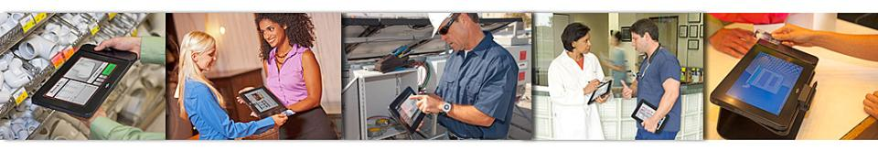
Connected, Flexible and Integrated
Robust features offer convenient expansion, connectivity and mobility
802.11 ac Wi-Fi, Bluetooth®, 4G LTE Mobile Broadband and GPS
Front and rear facing cameras for documentation and collaboration
USB, SD Card Slot, Audio In/Out, Video Out
Countertop docking station, arm mounts and vehicle mounts with added expansion options
Cases and sleeves for mobile workflows

Slide 17
Durable & Mobile
Tested to conditions mobile workers face, the CL920 is designed to withstand harsh environments
Durable
Internal magnesium frame for greater structural rigidity
Solid State Drives (SSD) for performance and durability
Durable Corning® Gorilla™ Glass 3 display with flexible input options
Tested to MIL-STD-810G durability specifications and IP-52 ratings against moisture, dirt or dust
Easily cleaned with standard cleansers
Mobile
Lightweight at 1.9 pounds (.84 kg)
Thin at less than .63 inches thick (16 mm)
Over 8 hours of battery life* for extended productivity
*Based on MobileMark 2007 test

Slide 18
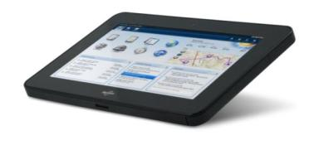

Balanced & Optimised
The Motion CL920 offers a balance of performance and battery life with the Intel® Pentium™ N3540 CPU
Intel® Pentium™ N3540 Dual Core processor (2.16 GHz with Burst Frequency to 2.66 GHz)
Over 8 hours of battery life* from a 4 cell (43Whr) battery
69% improvement in performance* over previous Atom-based systems
4 GB RAM
System storage: 64 GB and 128 GB SSD
Over 8 hours of battery life
*Mobilemark score vs. Cedartrail-based tablet, battery life based on Mobilemark 2007 test

Slide 19
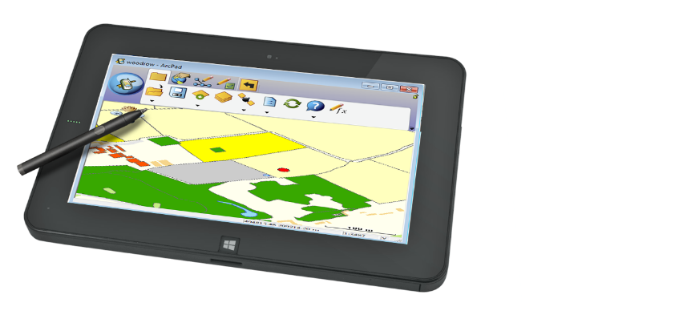
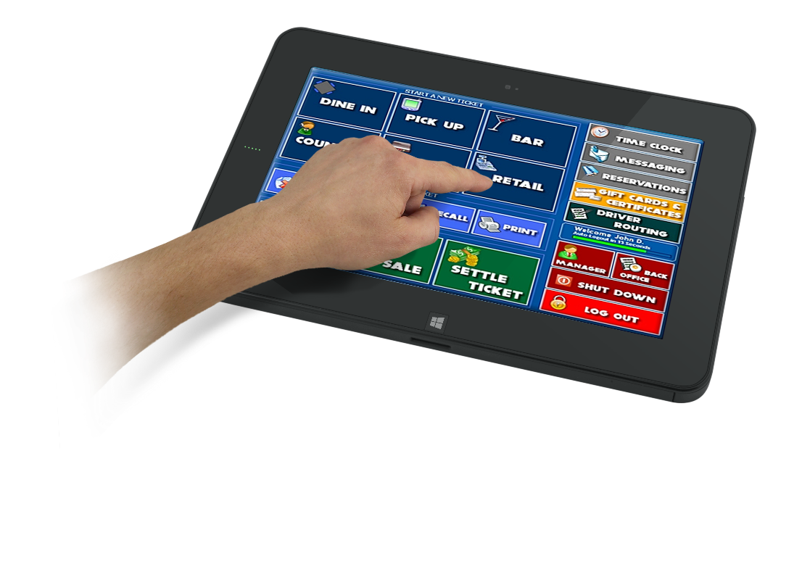
Bright, Visible and Durable Display
The convenience of touch navigation, accuracy of pen input and the durability of Gorilla Glass
Flexible Input and Navigation
Supports Windows 8.1 natural touch gestures - pinch or tap for scrolling, panning, rotating and zooming
Ideal for computing while standing, using one hand for input
Digitizer pen for use with applications that are not optimized for touch
Supports small-target navigation and convenient signature capture

Slide 20
Motion® CL920 Peripherals Overview

Slide 21


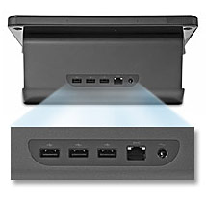
Intuitive Countertop Dock
The countertop docking station is the perfect accessory for the standing user to display information or complete touch-based transactions while connected to USB compatible peripherals.
USB (3)
Ethernet
Power

Slide 22
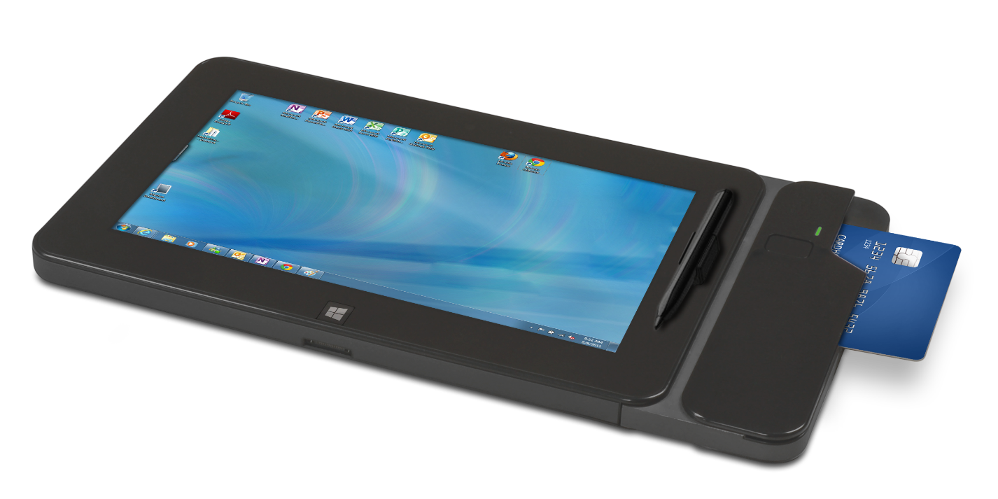
Motion CL920 SlateMateTM
An industry-first productivity module that transforms the CL920 Tablet PC into an automated data acquisition and transaction processing tool

Slide 23


Powering Point of Sale

Slide 24
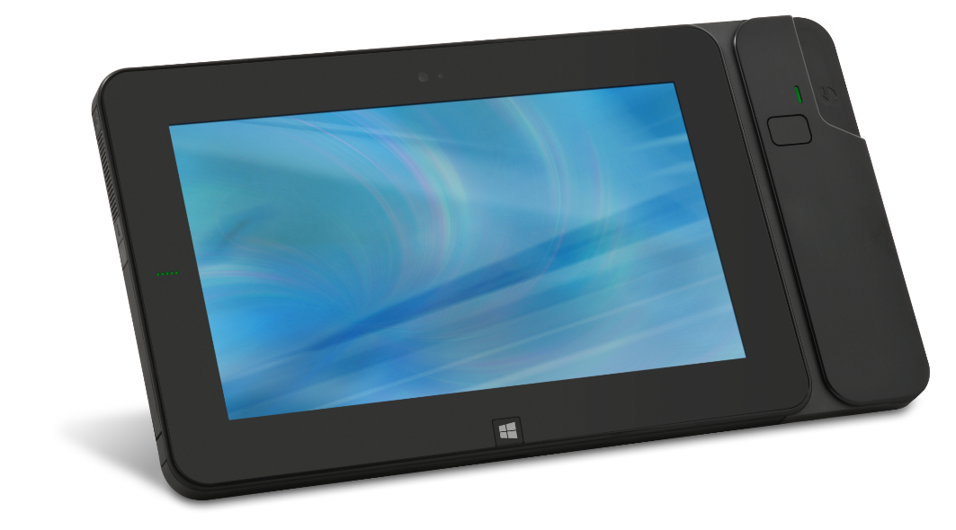
CL920 SlateMate™
An integrated expansion module that provides seamless added functionality
Secure attachment to the internal frame ensures durability
First-of-its-kind design to support future configurations for mobile productivity
Mobile Innovation
SlateMate™ is available at the time of purchase only and with select configurations of the CL920.

Slide 25
CL920 SlateMate™
First available SlateMate™ features MSR and BCS, enabling secure, reliable data capture and transaction processing
Magnetic Stripe Reader
MagTek® IntelliHead MSR known for quality and security
MagTek’s Magensa™ service certified with maximum processors for seamless deployment
Track 1, 2 & 3 for driver’s licenses, loyalty cards and credit cards
Supports Credit & Signature Debit Transactions
Barcode Scanner
Reads 100+ major barcodes
Small size, low power consumption extends mobile productivity
1D: barcodes on most packages
2D: square codes used for coupons, etc.

Slide 26
CL920 SlateMate ™
CL920 SlateMate with MSR and BCS, enables secure, reliable data capture and transaction processing
Security & PCI Validation
Encryption TDES (Triple Data Encryption Algorithm)
Supports PCI Requirements
Theft Protection
Leading security software that helps avoid tablet theft; Computrace® by Absolute Software
Integration
Windows-based for integration of MPOS into existing systems
Device Management
No need for pairing
MagTek IntelliHead MSR
Serves as seamless, simple payment terminal
Up to a full workday of power and rapid charging options
Locking solutions available

Slide 27



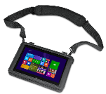


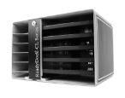
Motion CL920 Accessories
Multi-Tablet Charging Station
Keep up to 4 CL920s ready to go without the clutter of charging cables. The sleek design is perfect for customer- facing environments.
Countertop Dock
The Countertop Dock has a versatile surface for displaying information or completing touch-based transactions while connected to USB compatible peripherals.
Carry Sleeve
Compatible with SlateMate™, the Carry Sleeve provides a convenient way to transport and protect the CL920. Includes a built-in x-strap and adjustable and removable shoulder strap.
Locking Mobile Dock
The Locking Mobile Dock has a built-in key lock for added security, offers full port replication, charging capability, vibration protection and durability for vehicle and other mobile environments.
X-Strap
Two flexible straps that attach directly onto the back of the CL920, providing users with a secure grip on the tablet, while increasing stability and freedom of movement.
ReadyDock
The lockable cabinet can be configured to store CL920 Tablet PCs and CL-Series SlateMates™. The ReadyDock™ is the most efficient way to house, charge, sync and secure your Motion tablet PCs.
Note: All 3rd party products are not warranted, supported or serviced by Motion. Not all CL920 accessories shown.

Slide 28
CL920 Product Tour

Slide 29
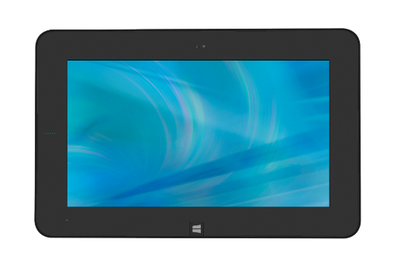
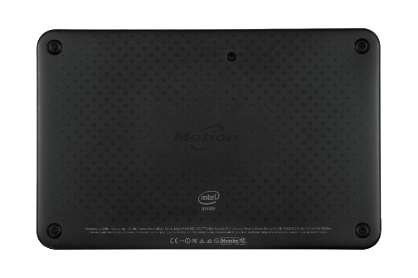
CL920 Product Tour
Front
Back

Slide 30
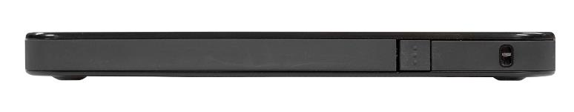

CL920 Product Tour
Right
Left

Slide 31
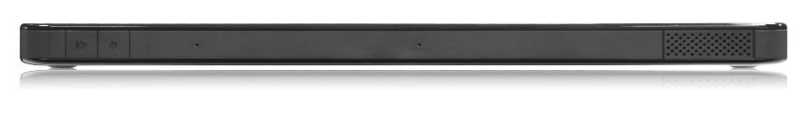
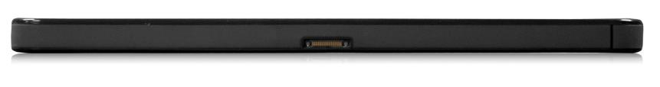
CL920 Product Tour
Top
Bottom

